Slide 1
Storybook
For Student’s Grade

Slide 2
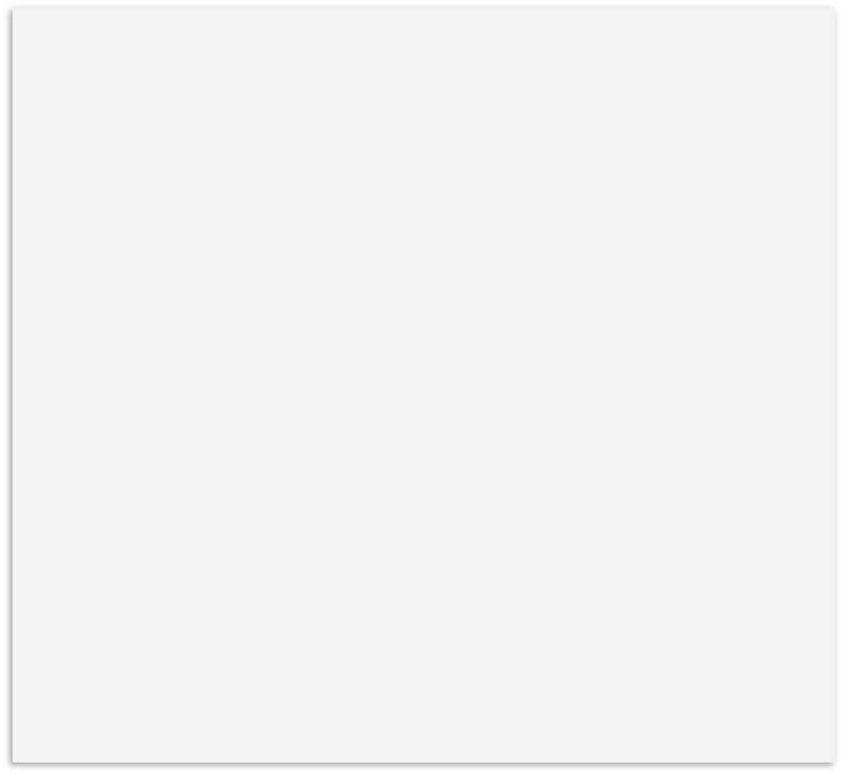
Student Records
Subjects
Math
Physics
Chemistry
Java
Web development
Search Student
Student 1
Grade
100
Student 2
Grade
95
Student 3
Grade
96
Add
Edit
Delete
Student 3
Grade
100
Add Student
Edit Student
Delete

Slide 3
Student Records Menu
Student Information
View Holds
Midterm Grades
Final Grades
Academics Transcripts

